Slide 1
Netflix Stock Price Analysis
Analysis and visualization of 2017 Netflix stock price

Slide 2
Summary:
As the data visualization developer at Yahoo Finance! I have created 4 visualizations to help explain the Netflix share price for the year 2017:
A Violin Plot examining the 2017 price distributions per quarter
A Scatter Plot examining the divergence between actual and estimated EPS
A Bar Graph plotting quarterly revenues vs earnings
A Line Graphs comparing Netflix and Dow Jones price change

Slide 3
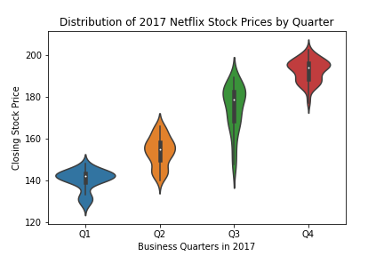
Netflix Stock Price Per Quarter

Slide 4
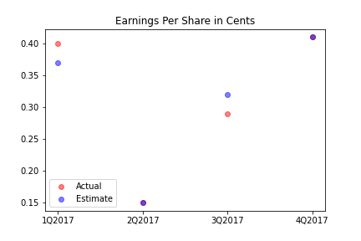
Earnings Per Share Actual VS Estimates
Actual earnings per share has remained close to estimates with actual earnings matching the estimates in Q2 and Q4
Netflix outperformed earnings estimates in Q1

Slide 5
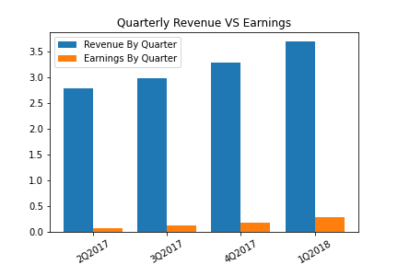
Quarterly Revenues and Earnings
Both revenues and earnings have been trending upward each quarter maintaining roughly 7% earnings
Revenues have grown at a faster pace than actual earnings over 2017

Slide 6
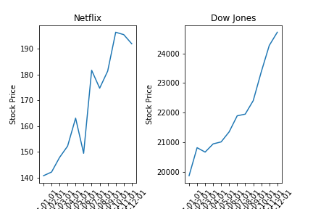
Stock Performance VS Dow Jones
Netflix has outperformed the DJIA by nearly 10% over the course of 2017

